Slide 1
UIdaho/USDA’s PNW Climate Hub Map/Data Automation Project
Donovan VanSant
University of Idaho
Notes:
Hello, my name is Donovan VanSant and today I will be walking you through the process I underwent developing scripts in Python to automate making over 600 maps for the PNW Climate Hub. Project Description: This joint venture between the University of Idaho (UI) and the PNW Regional Climate Hub to create a web-based, digital resource that provides downscaled, simple, current and projected climate maps of the PNW region.

Slide 2
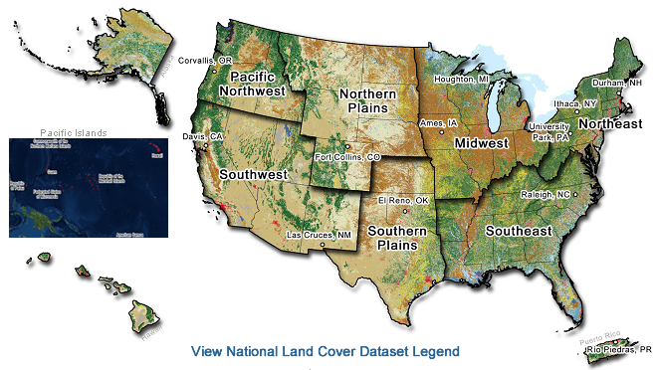
Climate Hub Regions
Notes:
PNW Includes Alaska, Idaho, Washington, and Oregon. The datasets used for mapping exclude Alaska so the regions of interested are all the other states. USDA’s Climate Hubs Vision is robust and healthy agricultural production and natural resources under increasing climate variability and climate change.

Slide 3
USDA? Climate Hub?
The mission of the Climate Hubs is to develop and deliver science-based, region-specific information and technologies, with USDA agencies and partners, to agricultural and natural resource managers that enable climate-informed decision-making, and to provide access to assistance to implement those decisions. This is in alignment with the USDA mission to provide leadership on food, agriculture, natural resources, rural development, nutrition, and related issues based on sound public policy, the best available science, and efficient management.
Notes:
The purpose of the Hub is to deliver science-based knowledge and practical information to farmers, ranchers, forest landowners, and Native American tribes that will help them to adapt to climate change.

Slide 4
Deliverables?
Static, downloadable maps and datasets for Historical, RCP4.5, RCP8.5
Cover 6 climate metrics of interest to land managers
Mean Minimum and Maximum Temperature
Accumulated Precipitation
Reference Evapotranspiration
Freeze-free Days
Cold Hardiness Zones
Growing Degree Days
Notes:
RCP representative control pathways (climate outcomes). Three different scenarios. The first three variables each have an annual, winter, spring, summer and fall component. The last three do not. Datasets will be provided in geotiff format for each region, variable, and time – they were originally stored in NetCDF files.

Slide 5
How was it done?
Automate as much as possible with Python/ArcPy
Use Requests (HTTP for humans) Python module to download NetCDF datasets
Convert NetCDF files into raster layers (geotiff)
Clip raster layers to regions
Get min, max, mean, and std for each region/variable/time period
Create .lyr color ramp for consistent symbology
Make map document templates for each region
Loop through all layers
Add layer to map document
Style layer using consistent .lyr file
Save map document as a pdf (could be another format like jpeg, gif or png)
Notes:
Most of this was able to be done using Python/ArcPy. Where it was not currently possible I will try to address.

Slide 6
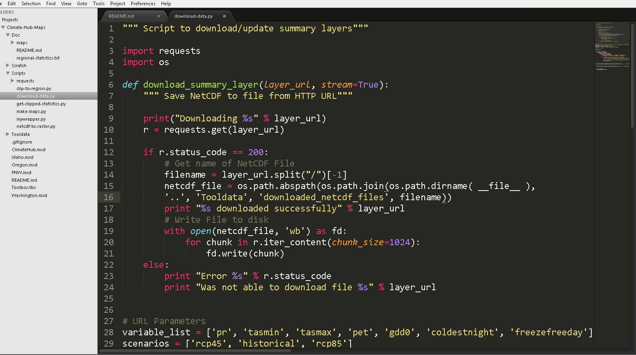
download-data.py
Notes:
Wrote function that takes a URL to a NetCDF and downloads it via HTTP. Looped over all variables, scenarios, and time frames. NetCDF files get stored in /Tooldata/downloaded_netcdf_file. Anyone want to see it in action?

Slide 7
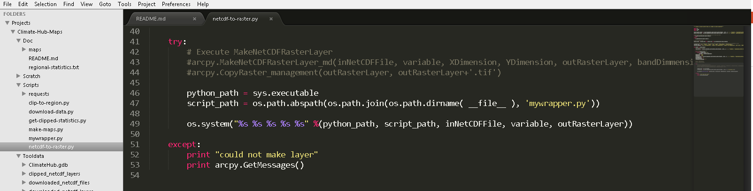
netcdf-to-raster.py
Notes:
Memory leak even when using Python’s del and arcpy.Delete_management(). I ran into a similar issue trygin to convert many NetCDF files to raster on another project. Same exact code worked perfectly in 10.2 so I assume this is some bus in 10.3

Slide 8
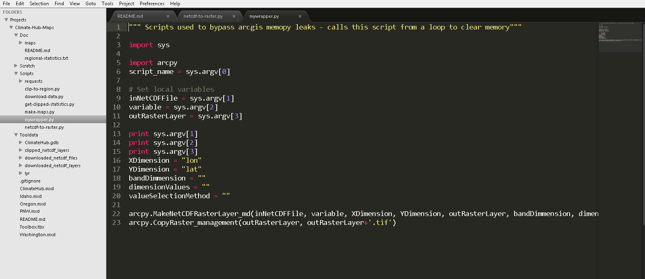
Solution?? – mywrapper.py
Notes:
Wrote command line tool that takes command line arguments. Basically, it calls up ArcPy, then exits after converting one NetCDF to raster.. Slow process but it works perfectly with every layer using the exact same code!

Slide 9
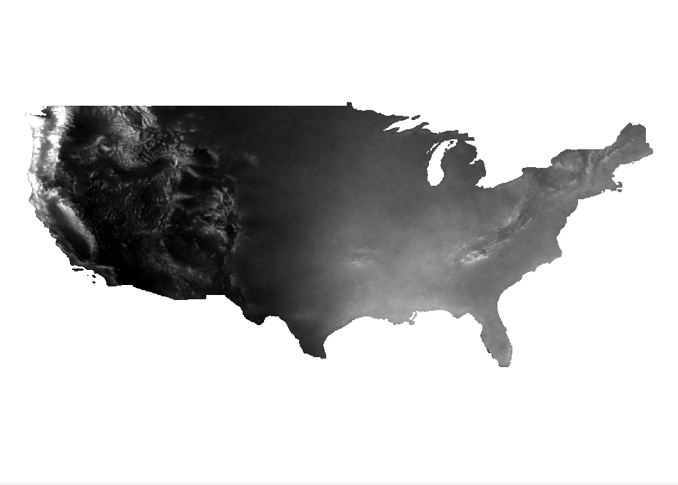
Results
Notes:
This is what an annual precipitation looks like over 30 year for CONUS – we were only concerned with PNW region and states

Slide 10
Clipping
Used extract by mask -> requires spatial analyst extension as it can clip a raster layer to a region (polygon)
Clipped all raster layers to each region generating new raster files with a naming convention using the region at the beginning of the file names
Idaho_macav2metdata_coldestnight_20102039_rcp45_20CMIP5ModelMean.tif
Python code in clip-to-region.py

Slide 11
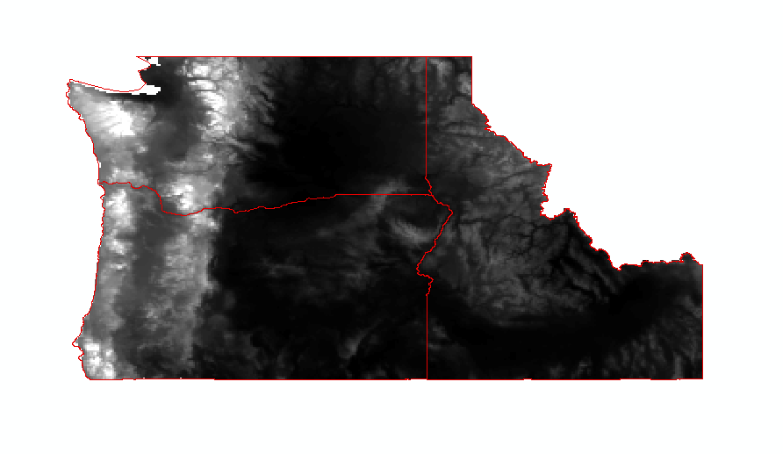
Notes:
Example of the state boundaries used to clip the PNW region – US TIGER LINES 2015 stored in ClimateHub.gdb/Regions

Slide 12
Regional Statistics
Minimum, maximum, mean, and standard deviation
Used to create .lyr files for consistent raster symbology across each region/variable through time
Creates a comma separated file with all of the information needed – a manual task is to create the .lyr file for each combination
Code in get-clipped.statistics.py

Slide 13
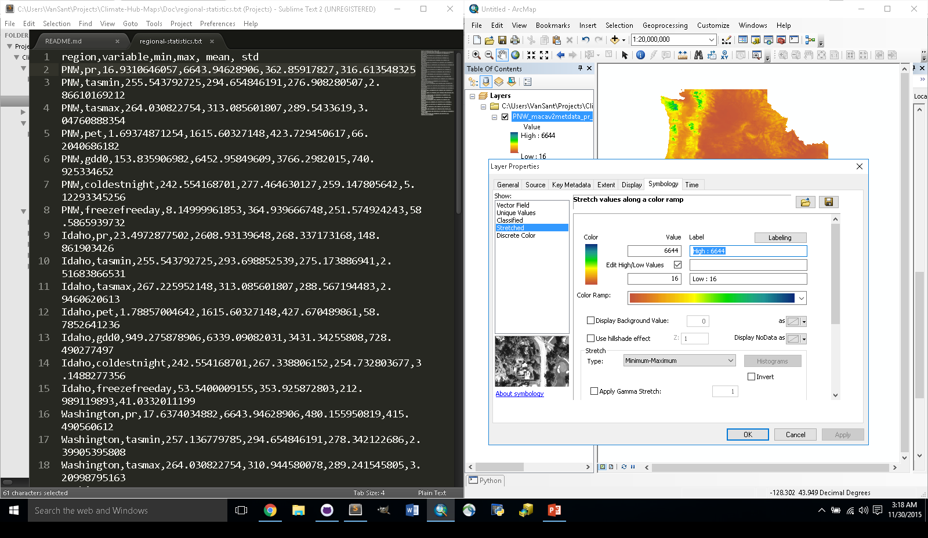
Creating .lyr files
Notes:
Use the regional statistics from the last step and select a color ramp

Slide 14
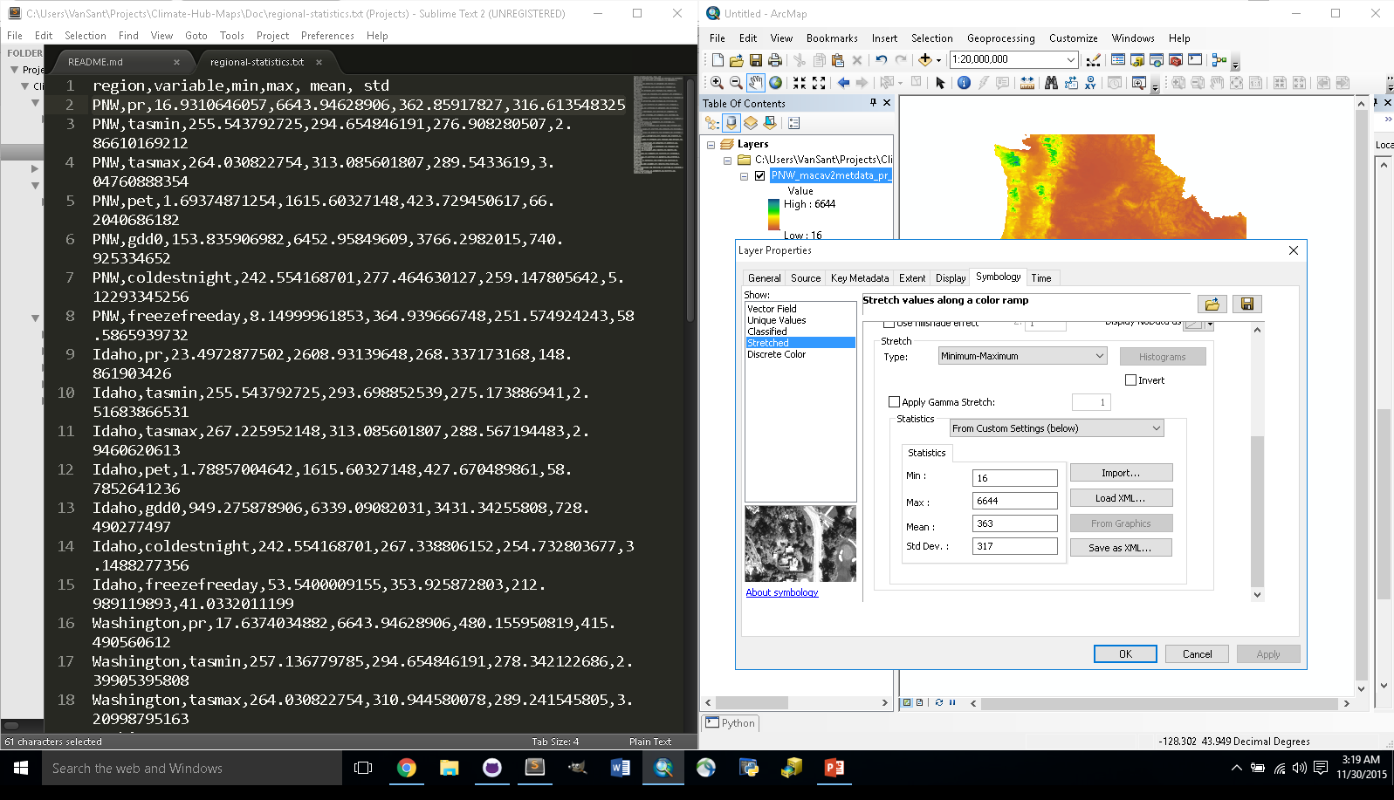
Creating .lyr files - continued
Notes:
Since statistics can be store with the raster layer it is important to Stretched needs to be selected on the left-hand side of the screen. Under type Minimum-Maximum needs to be checked. Scroll down and select from custom settings below instead of from each raster. The values can then be updated and a color ramp can be chosen.

Slide 15
Map Documents
One for each region
In this case Idaho, Oregon, Washington, and PNW region
Common naming convention tip
Was done by hand
Cannot create a blank MXD in ArcPy
Notes:
Using a common naming convention makes it really easy to loop through the correct data – if contains, startswith on python strings or you can split, filter with regex . – I found years ago you can make a copy of an mxd though… It is possible to copy an empty Map Document and use it in a similar manner as creating a new map document…..

Slide 16
make-maps.py
Opens map document for correct region to get layout view elements
Adds raster layer
Applies consistent symbology from region-variable.lyr files
Exports maps as PDF files to /Doc/maps using the same naming convention with the region in front of the layer_name.

Slide 17
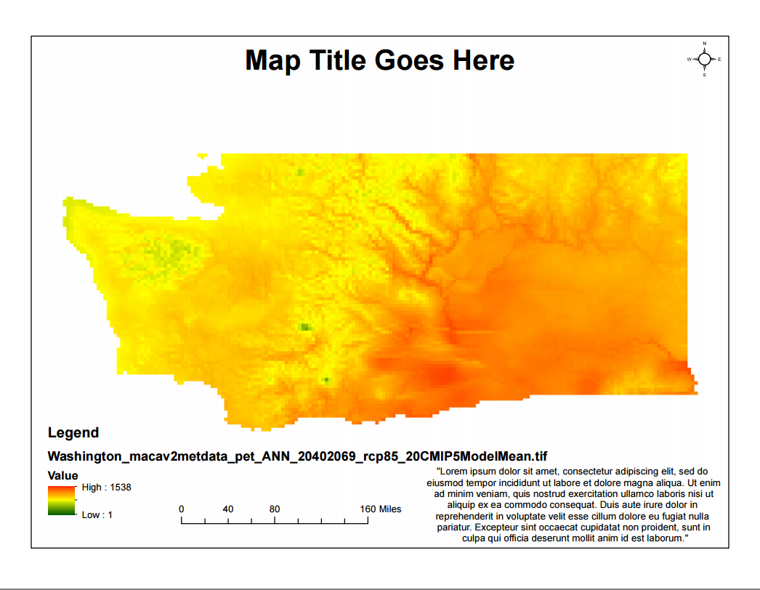
End Results
Notes:
This is an example of the Washington.mxd with a PET variable, Annual, for RCP85. The processed datasets are also available and will be ready to download in geotiff format from the world wide web at some point in the future.

Slide 18
Questions?

